Slide 1
Pap smear
Dr Shanthi Serene Sylum V MD(Hom)
Professor & HOD
Dept: Obstetrics & Gynaecology

Slide 2
What is pap smear test?
A Pap smear, also known as Papanicoloau smear, is a microscopic examination of cells scraped from the cervix and is used to detect cancerous or pre-cancerous conditions of the cervix or other medical conditions.
The Pap smear has helped reduce cervical cancer incidence and mortality rates by 75%.

Slide 3
CONTINUED…
A Pap test should be performed during the second half of the menstrual cycle (Day 14). Sample collection usually begins with appropriate instruction to the patient. Patients must abstain from sexual intercourse and avoid using any vaginal medication or contraceptives 48 hrs before sample collection.

Slide 4
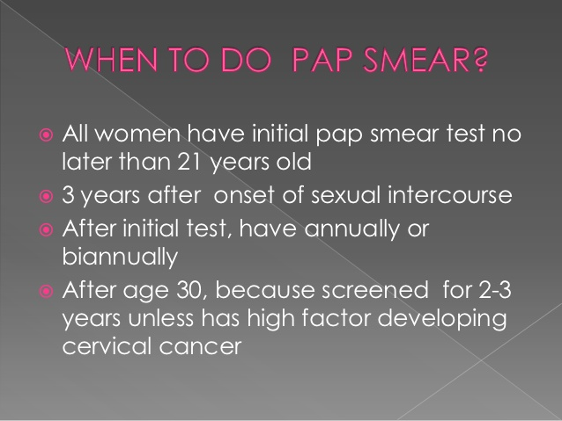

Slide 5
OBJECTIVE OF SCREENING.
The objective of screening is to reduce the incidence and mortality from cervical cancer.
Even a single smear in a life time, if appropriately timed, will produce some benefits.
If extended only to high-risk group, the mortality from the cancer deaths will still be reduced to 60 percent.

Slide 6
Pap smear test has been effective reducing the incidence of cervical cancer by 80% and the mortality by 70%.
As a result of Pap test, more and more preinvasive carcinoma is detected.
Opportunistic screening done by a trained staff is effective when follow-up (call and recall) is maintained.
Pap testing after total hysterectomy, done for benign lesion is not recommended.

Slide 7
RISK FACTORS..
○ Low risk Screening
– Women who had never been sexually active
– Women aged 70,who had three negative smears in the past 10 years
– Women who had hysterectomy for benign lesion.

Slide 8
○ At risk
– Women aged 21 years or having sex for last 3 years up to the age of 70 who are or have been sexually active.
Screening schedule.
Every 2–3 years after age 30 with 3 negative yearly smears

Slide 9
○ High risk
– Early marriage
– Early intercourse
– Early pregnancy
– Smoking habits
– Oral pill users
– Multiple sexual partners
– Human papilloma virus infection and HSV(Herpes simplex virus) Type -2
– Women who are immunosuppressed (HIV positive).
SCREENING SCHEDULE
Every 2–3 years after age 30 with 3 negative yearly smears

Slide 10
Procedure…
Vaginal or cervical discharge: The patient is
advised not to have vaginal douche at least in
previous 24 hours. Cusco’s bivalve speculum
is introduced without lubricant and prior to
internal examination. The material collected in
the posterior blade or from the cervical canal as
the case may be, is taken either by a platinum loop
or swab stick.

Slide 11
Cervical scraping: The material from the cervix is
best collected using Ayre’s spatula made of wood or
plastic. Whole of the squamocolumnar junction has to
be scrapped to obtain good material.

Slide 12

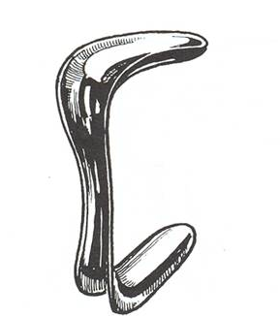
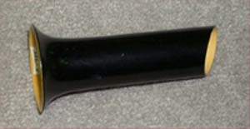
Various types of speculums are available-
1. Cusco’s speculum
2. Sim’s speculum
3. Ferguson’s speculum

Slide 13
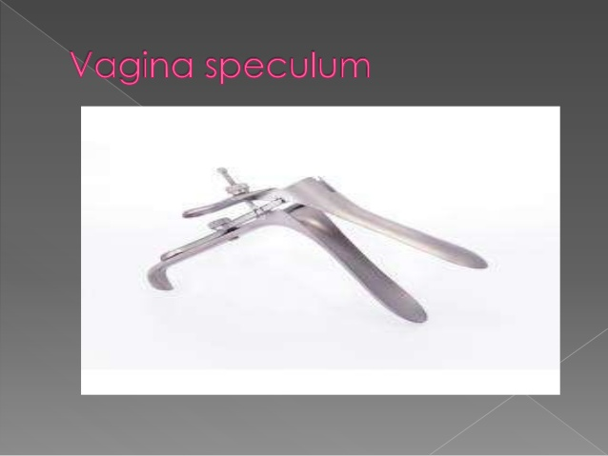

Slide 14
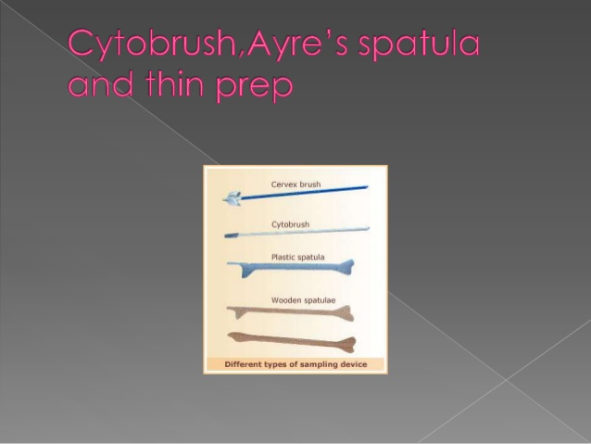

Slide 15


Slide 16


Slide 17
Pre-requisites are,
Request self empty bladder except
stress incontinence.
Lower bowel should be empty {rectum &
pelvic colon}.
A female attendant.
Get consent from the pt or guardien
for examining a minor or unmarried.
Very good light source.

Slide 18


Slide 19

Requirements
A calm, aerated & well lighted room
Examination table
Pillow & drapings
Examining sterile gloves
Sterile lubricant
Speculum
Sponge holding forceps
Swabs - cotton balls, Pads
Arey’s spatula
Cyto brush
2 glass slides & cover slips
Fixative {liquid or spray}

Slide 20
Position of the patient for pelvic examination
Dorsal position – Commonly adopted one
Hip & knees flexed
completely
Lateral or Sim’s Ideal to view anterior
Position vaginal wall.
Lithotomy position – Ideal for examination
under anaesthesia in OT
& vaginal operations

Slide 21

Positions

Slide 22
Position of the physician for pelvic examination
Physician stands on Rt side - It provides a better view of external genitalia
It gives an effective performance
of bimanual examination
BUT
The physician can be examined in any
position of the physician’s choice.
Notes:
Ref: Dutta – Page 94

Slide 23
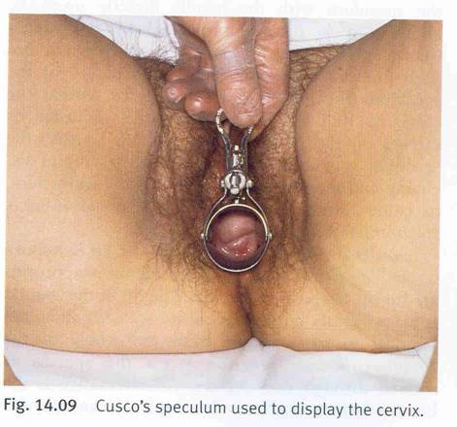
Cusco’s – used in dorsal position
cervix can best visualised with it.
Collection of discharge from cervix or vaginal fornics made easy.

Slide 24
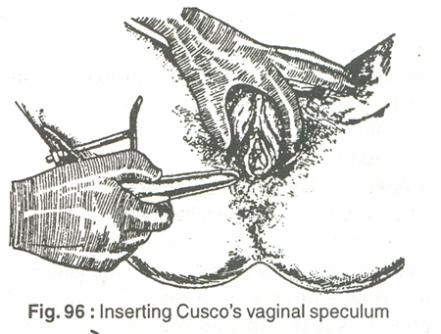
Procedure
It should be explained to the patient first.
Moisten speculum
Hold in Rt hand
Separate the labia with
thumb & index finger
of Lt hand.
Hold speculum blade in an oblique direction & insert into vagina .

Slide 25
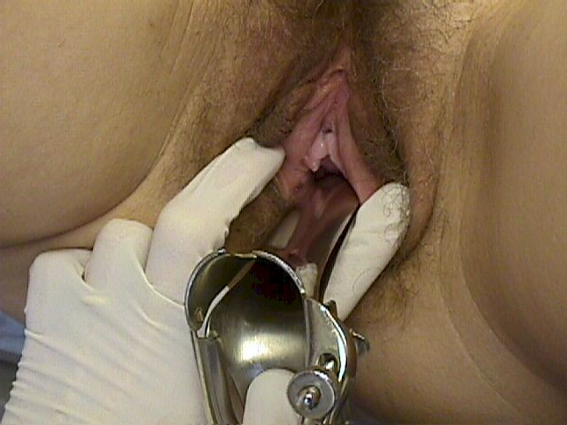
Then rotate gently to transverse plain on the posterior vaginal wall.
Speculum position is adjusted till the cx & vagina can be viewed

Slide 26
CYTOLOGIC PAP
Cytobrush collects endocervical cells from the external os.
Wooden spatula collects cells from the external cervix(transitional zonejunction).
Apply to the glass slide , fix immediately to avoid drying artifacts.

Slide 27
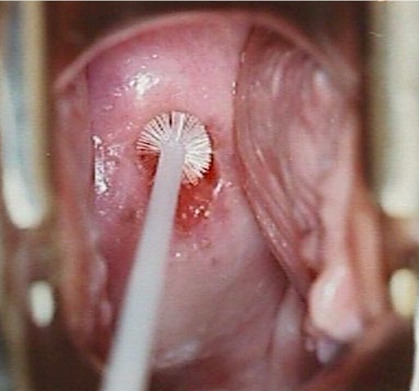
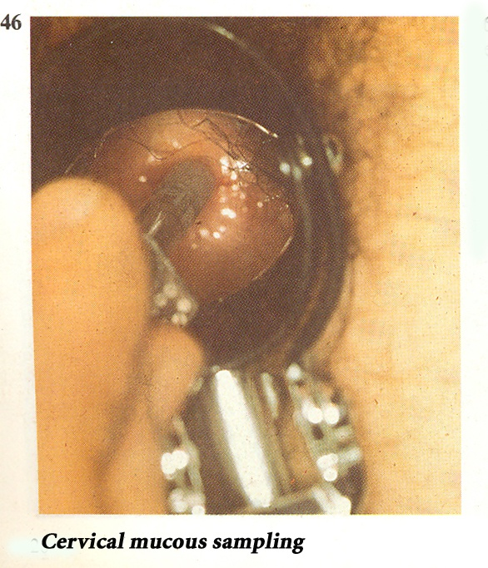
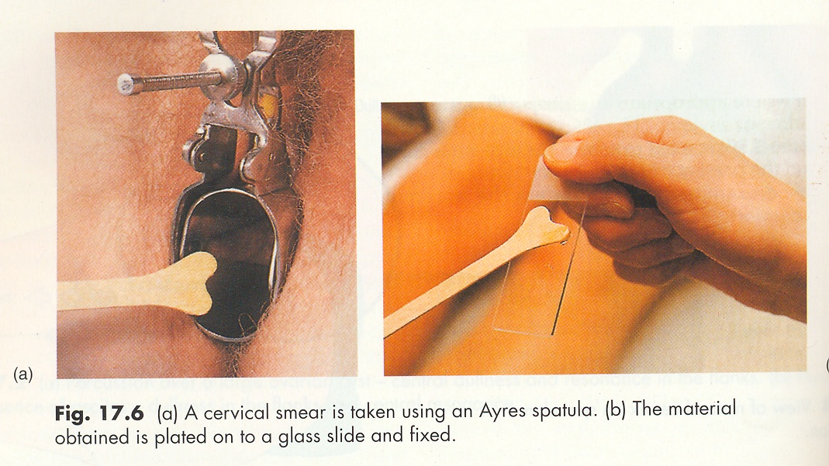
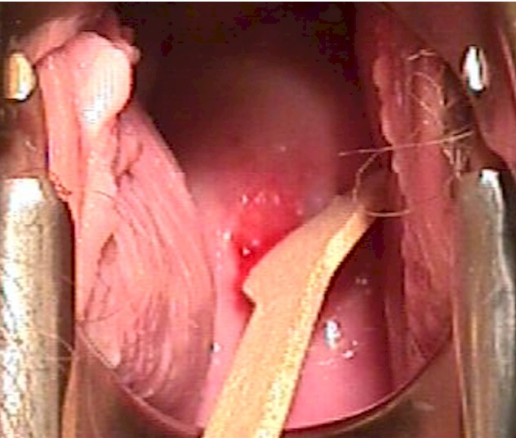
Pap’s smear collection

Slide 28
Fixation and Staining
The principle of the staining is to achieve clear nuclear definition and to define cytoplasmic coloration.
The material so collected should be immediately spread over a microscopic slide and at once put into the fixative ethyl alcohol (95%) before drying.

Slide 29
After fixing for about 30 minutes, the slide is taken out, air dried and sent to the laboratory with proper identification.
The slide so sent is stained with Papanicolaou’s method and examined by a trained cytologist.
Indeed, trained cytopathologist and cytotechnologist are vital for the success of any screening program .

Slide 30
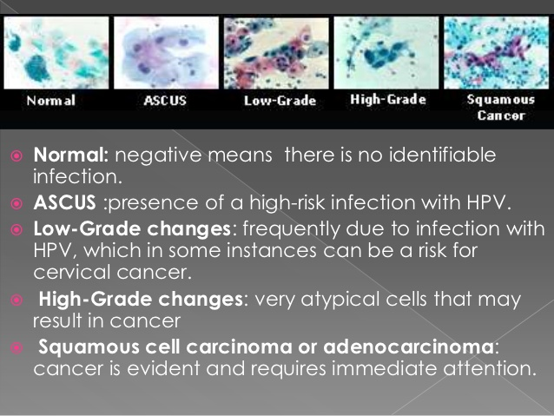

Slide 31
Normal Squamous cells and endocervical cells

Slide 32
DYSKARYOSIS
Morphological Abnormalities of the
Nucleus (Dyskaryosis )
 Disproportionate nuclear enlargement
 Irregularity of the nuclear outline
 Abnormalities of the nucleus—in number, size
and shape
 Hyperchromasia
 Condensation of chromatin material
 Multinucleation

Slide 33
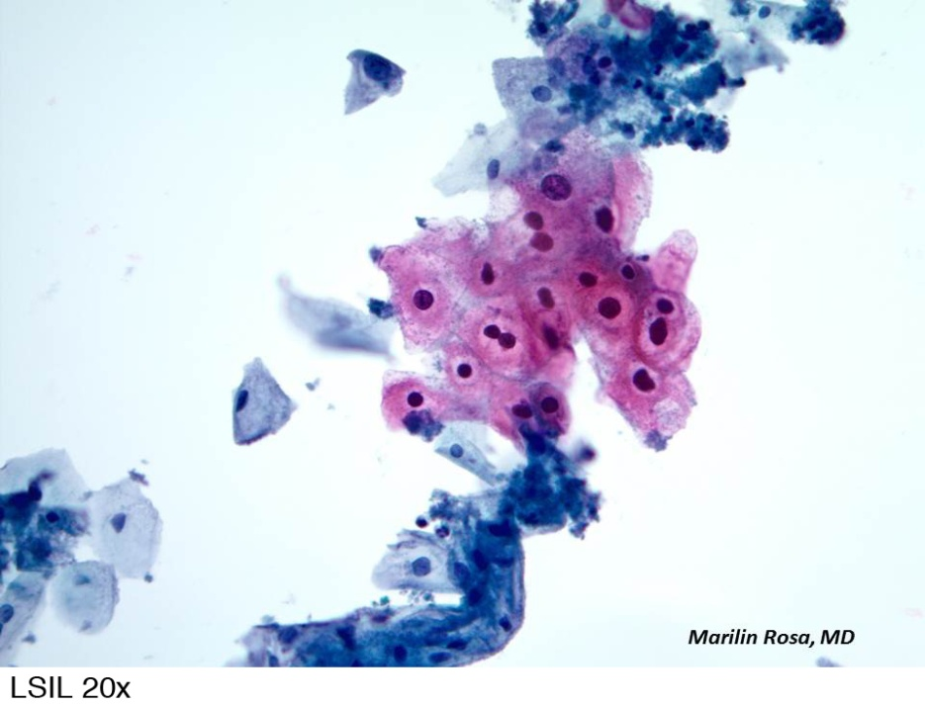
Abnormal cells
Mild dyskaryosis
Cells are of superficial or intermediate type squamous cells.
Cells have angular borders with translucent cytoplasm.
The nucleus occupies less than half of the total area of cytoplasm.
Binucleation is common.
Mild dyskaryosis correlates with cells from surface of CIN I.

Slide 34
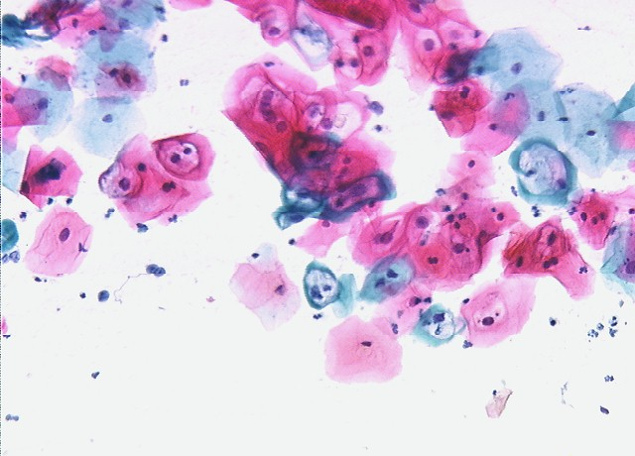
Continued…
Moderate dyskaryosis
The cells are of intermediate,parabasal or superficial type squamous cells.
Cells have more is proportionate nuclear enlargement and hyperchromasia compared to mildly dyskaryotic cells.
The nucleus occupies one half to two-thirds of the total area of the cytoplasm.

Slide 35

Continued..
A severely dyskaryotic cell with an elongated tail of cytoplasm is described as a tadpole cell.
Severely dyskaryotic cells correlate with CIN 3.
Severe dyskaryosis
Cells are of basal type, looking round, oval, polygonal or elongated in shape.
The abnormal cells may occur in clumps or singly.
The abnormal nucleus either practically fills the cell or there may be a thick, dense and narrow rim of cytoplasm around it.
The nucleus is irregular with coarse chromatin pattern. The cells may be different in size and shape.
Severely dyskaryotic cells when
elongated, are sometimes called fiber cells.

Slide 36
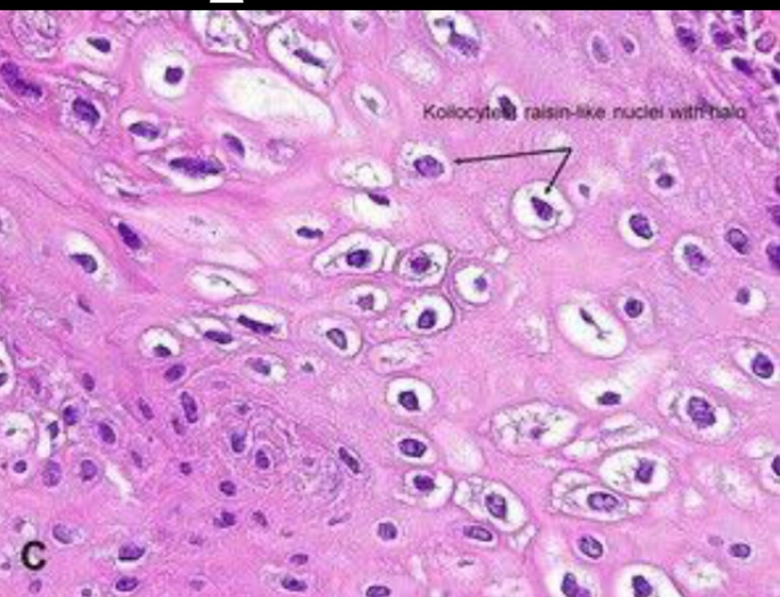
Koilocytosis
The nuclear abnormalities associated with human papilloma virus infection.
Cells show typical central clearing (perinuclear halo) with peripheral condensation of cytoplasm.
The nucleus is irregulary enlarged and shows hyperchromasia with multinucleation.
Patients with koilocytosis on repeated smear, need colposcopic evaluation.

Slide 37
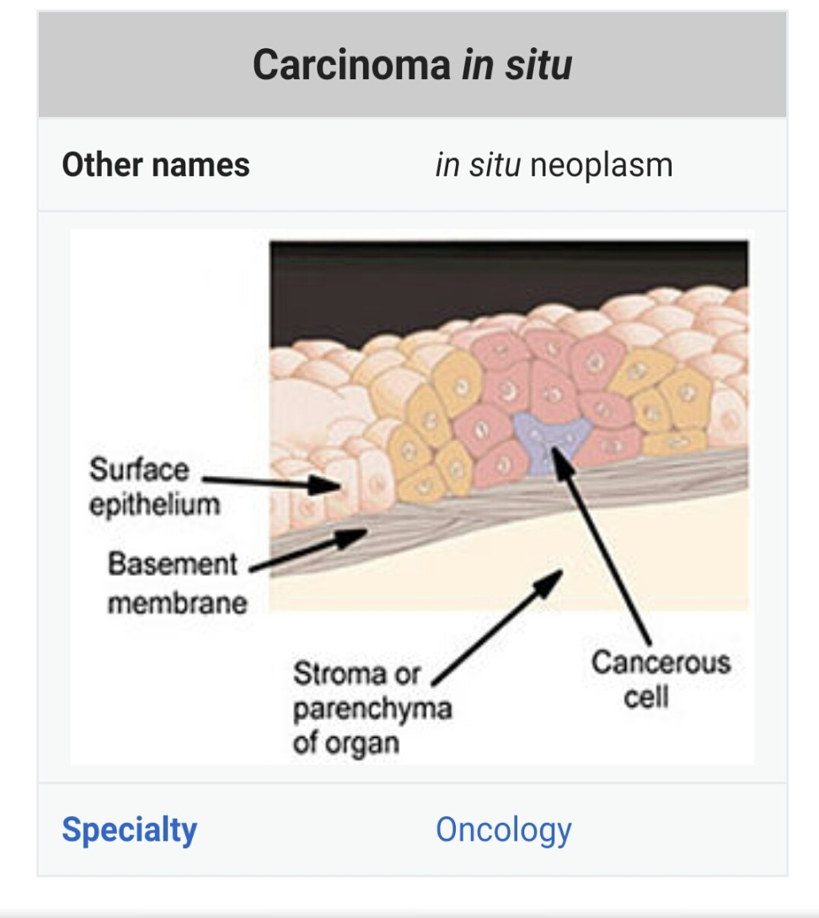
Carcinoma in situ
Cells are parabasal type with increased nuclear cytoplasmic ratio.
The nucleus may be irregular sometimes multiple.
The chromatin pattern is granular.
Cytoplasm is scanty.

Slide 38
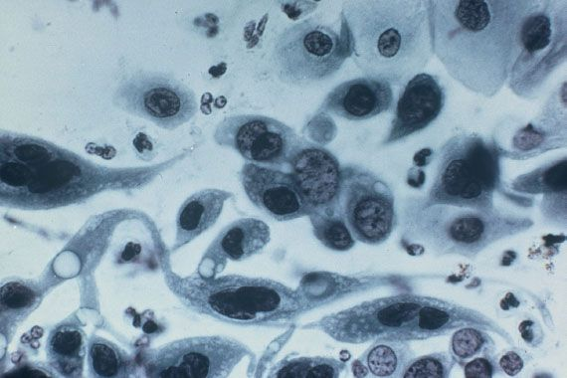
Invasive carcinoma—
Cells are single or grouped in clusters.
The cells show irregular nuclei and clumping of nuclear chromatin, which is also coarse.
Large tadpole cells are seen.

Slide 39
REPORTING SYSTEM
Reporting system on the grading basis (Papanicolaou’s) is replaced by some with two remarks only—normal or abnormal.
An abnormal smear indicates the presence of lesion either CIN and/or papilloma virus infection or invasive malignancy.
A doubtful or inconclusive smear dictates repeat smear.

Slide 40
PAPANICOLAOU’S GRADES
ACCURACY:
Diagnostic accuracy is 98% in cervical malignancy.
False negative rate is 15% may be due to :
1. Smear is too scanty.
2. Smear is too thick.
3. Smear poorly stained.
4. Smear is too bloody.
5. Smear is poor stained due to misinterpertation.
Abnormal cytology is an indication of colposcopic evaluation and directed biopsy after application of schiller’s or Lugol’s iodine.
In case of infection repeat cytology after controlling the infection.

Slide 41


